Slide 1
Security Risks Management
Lecture 4

Slide 2
Covered in this lecture:
1. Identifying assets
2. Calculation of attack likelihood
3. Risk assessment: risk identification, risk analysis, risk evaluation
4. Quantitative and qualitative methods
5. Risk treatment options
6. Risk monitoring

Slide 3
Risk: The effect of uncertainty on objectives
Information Security Risk: risk to organizational operations (mission, function, image, reputation, organizational assets, individuals, other organizations, and the Nation due to the potential for unauthorized access, use, disclosure, disruption, modification or destruction of information and/or information systems
Information System-Related Security Risk: risks that arise through the loss of confidentiality, integrity, or availability of information systems
Risk Management: A series of coordinated activities to direct and control challenges or threats to achieving an organisations goals

Slide 4
The purpose of risk management:
Ensure overall business and business assets are safe
Protect against competitive disadvantage
Compliance with laws and best business practices
Maintain a good public reputation
To provide Cyber Security guidance on IT security
Protect data used in all aspects
Protect all breaches resulting in loss of data

Slide 5
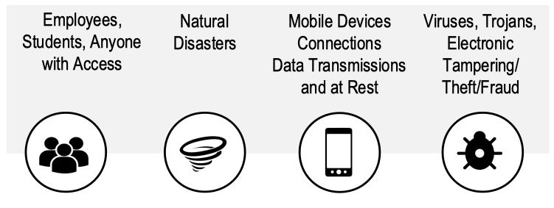
Sources of Cyber Security Risks

Slide 6
Cyber Security Risk Management
What is the acceptable level of risk?
What information is needed about threats and vulnerabilities?
What are the risks?
Do the mitigations produce acceptable level of risk?
How effective were the mitigations?
Did mitigating of risks add strategic value to the organization by moving closer to goal achievement?

Slide 7
Risk management
Risk assessment - identify and evaluate risk, its impact, and recommended risk reducing activities
Risk mitigation - prioritize, implements, and maintain risk reducing activities
Evaluation - continual process

Slide 8
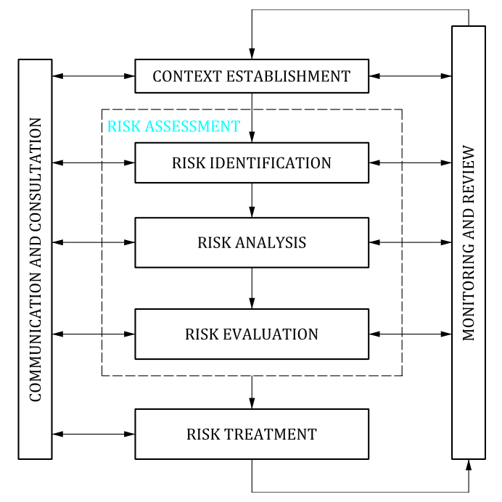
Security risk management process

Slide 9
Risk management
Determine Risk
Identify
Determine Risk Mitigation
Develop Risk register/Profile
Monitor

Slide 10
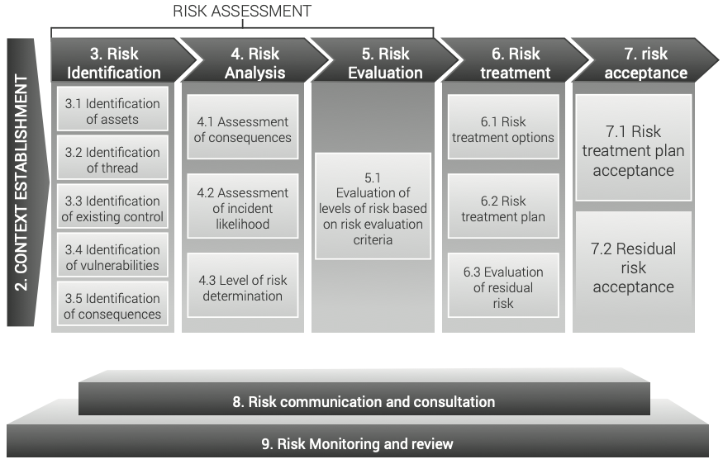

Slide 11
1. Identifying assets
Prior to conducting a Risk Assessment, it is most important to identify all the critical assets within the facility that require protection
Assets are resources of value to the facility, which can be tangible (e.g., installations, facilities, equipment, activities, operations, and information) or intangible (e.g., processes or a company’s reputation).
Asset values to an organization are central in determining the risks and the required security level.
Three types of assets that make up the information are identified: data, application software and physical assets (i.e. equipment, buildings, staff; assessed with locations where appropriate).

Slide 12
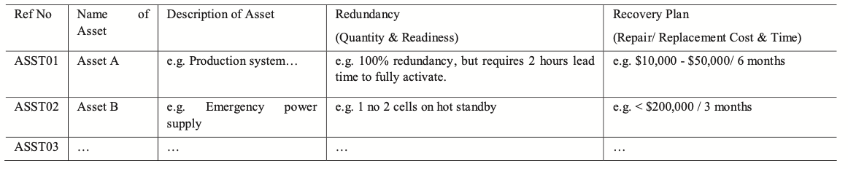
List of Critical Facilities in the Facility under Assessment

Slide 13
Assets
The valuation of information assets is regarded sometimes as a speculative activity, since it depends on who (e.g. sensitive information in hands of a competitor or a script-kiddie) and when (e.g. expirable passwords) possesses them.
Values are derived from the impacts of breaches of confidentiality, integrity, availability and non-repudiation, the widely accepted principles of information security.
Application software and physical assets are more easily valued

Slide 14
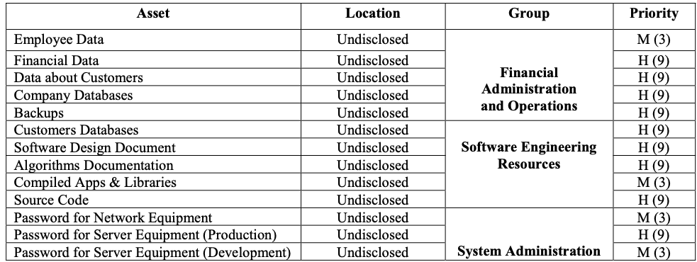
Asset group definition

Slide 15
2. Calculation of attack likelihood
Threat and vulnerabilities are investigated against selected asset groups
To perform and objective assessment, a quantitative evaluation is required to measure the probability (likelihood) and consequences of risks and considers their implications for project objectives.
The main tools used are interviews, sensitivity analysis, probability distribution, decision trees, and simulations.

Slide 16
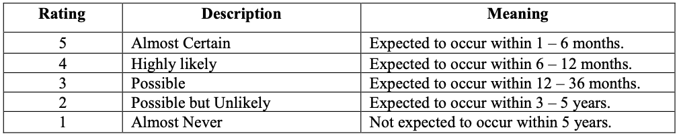
Example 1: Probability threshold definition

Slide 17
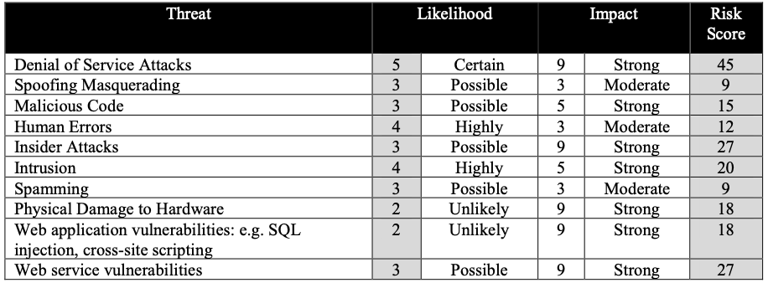
Risk rating

Slide 18
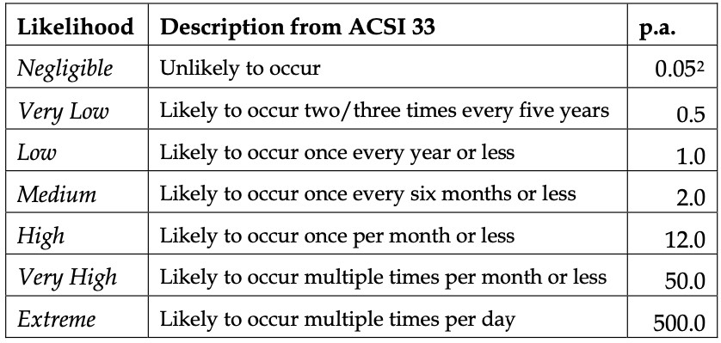
Example 2: Likelihood of security incidents

Slide 19
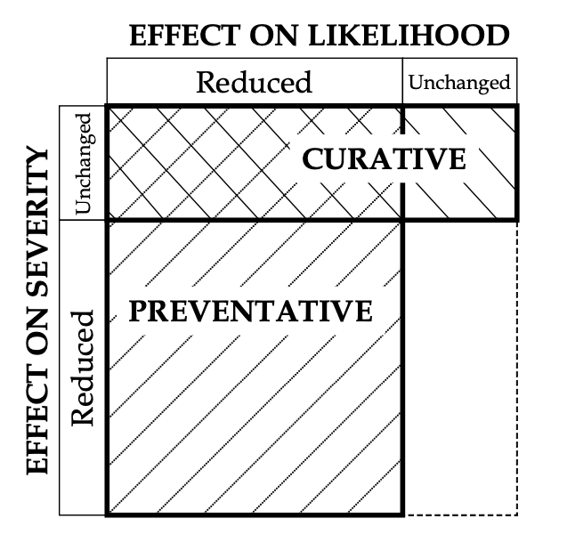
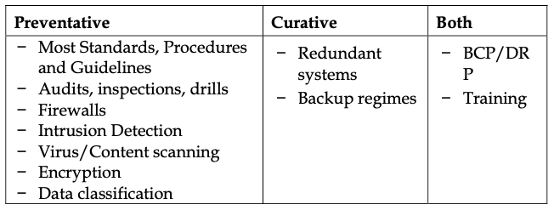
Schematic representation of countermeasure types

Slide 20
3. Risk assessment
The following activities are involved in the risk assessment:
Risk identification
Risk analysis
Risk evaluation

Slide 21
Risk Identification
The steps to risk identification are:
Identify your organization’s information assets
Classify and categorize said assets into useful groups
Rank assets necessity to the organization
To the right is a simplified example of how a company may identify risks

Slide 22
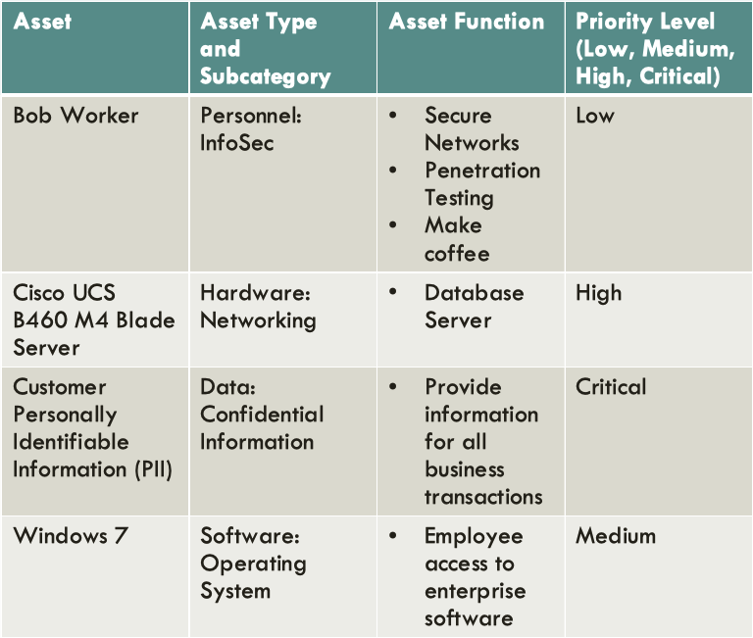

Slide 23
Risk Identification
Identification of assets – including more than just hardware and software
Identification of threats – probable to be of natural or human origin, and could be accidental or deliberate.
Identification of existing controls – a list of controls can be found in ISO/IEC 27001
Identification of vulnerabilities – probable to exist in the organization, processes and procedures, management routines, personnel, physical environment, information system configuration, hardware, software or communications equipment, dependence on external parties
Identification of consequences – possible to be manifested as a loss of effectiveness, adverse operating conditions, loss of business, reputation, damage, etc.

Slide 24
Risk analysis
Risk analysis is divided into three important sections:
Risk analysis methodologies – can be divided into qualitative and quantitative.
Assessment of consequences – heavily reliant on asset valuation.
Assessment of incident likelihood – takes into account how often the threats occur, and how easily the vulnerabilities may be exploited.
Level of risk determination – outputs a list of risks with values levels assigned.

Slide 25
Risk evaluation
Taking into the consideration the new understandings obtained from the risk analysis, risk evaluation also involves the decisions which need to be taken in cases when an activity should be taken or not, or what are the priorities for risk treatment, considering the estimated levels of risk.

Slide 26
4. Quantitative and qualitative methods of risk assessment
Qualitative risk analysis focuses on identifying risks to measure both the likelihood of a specific risk event occurring during the project life cycle and the impact it will have on the overall schedule should it hit. The goal being to determine severity. Results are then recorded in a risk assessment matrix (or any other form of intuitive graphical report) in order to communicate outstanding hazards to stakeholders.
Quantitative risk analysis uses verifiable data to analyse the effects of risk in terms of cost overruns, scope, resource consumption, and schedule delays. Ultimately, the purpose is the same; the difference is that it takes a more scientific, data-intensive approach.
Quantitative risk analysis assigns a numerical value to extant risks — risk A has a 40% chance of occurring, based on quantifiable data

Slide 27
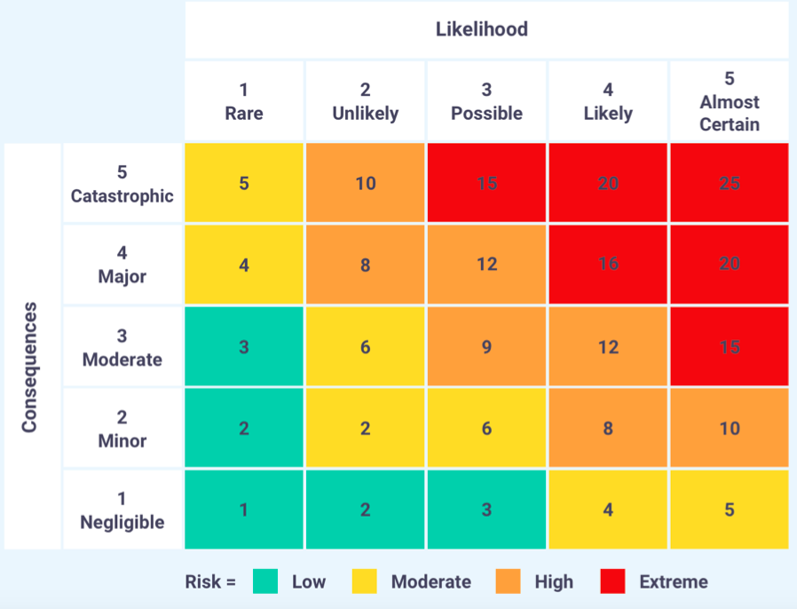
Assessment matrix of qualitative risk analysis

Slide 28
Methodology used by the Federal Emergency Management Agency
The methodology compiles the results of the threat assessment, vulnerability assessment and impact assessment to arrive at a numeric value for the risk to each asset against specific threat in accordance with the risk formula:
Risk = T x V x I (1)
Where
T = Threat Rating, V = Vulnerability Rating and I = Impact Rating

Slide 29
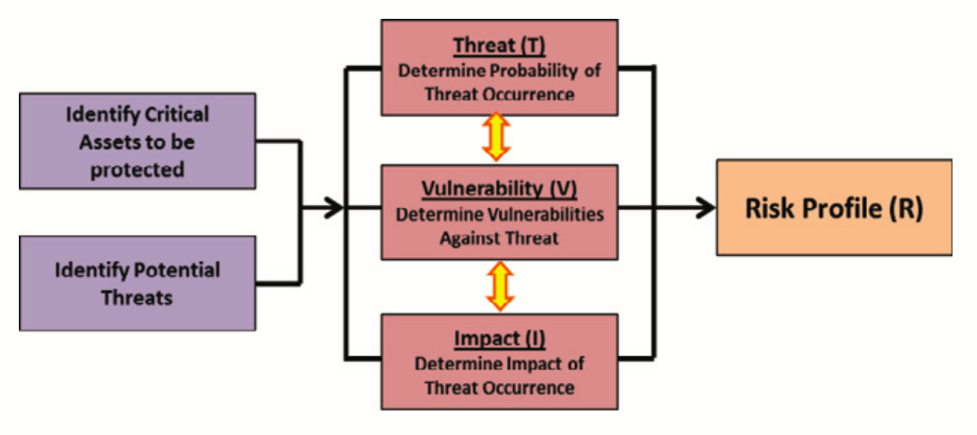
Risk Assessment Process

Slide 30
The entire process of Risk assessment
identify the assets and people that need to be protected
perform a threat assessment to identify and define the threats that could cause harm to the facility and its inhabitants. Identify assets and threats.
Conduct a vulnerability assessment to identify weaknesses that might be exploited by a terrorist or aggressor.
Compute the risk using the results of the asset value, threat, and vulnerability assessments.

Slide 31
Threat Assessment Rating
Very High (5) The likelihood of a threat, weapon, and tactic being used against the site or building is imminent. Internal decision-makers and/or external law enforcement and intelligence agencies determine the threat is credible.
High (4) The likelihood of a threat, weapon, and tactic being used against the site or building is expected. Internal decision- makers and/or external law enforcement and intelligence agencies determine the threat is credible.
Medium (3) The likelihood of a threat, weapon, and tactic being used against the site or building is possible. Internal decision-makers and/or external law enforcement and intelligence agencies determine the threat is known, but is not verified.
Low (2) The likelihood of a threat, weapon, and tactic being used in the region is possible. Internal decision-makers and/or external law enforcement and intelligence agencies determine the threat exists, but is not likely.
Very Low (1) The likelihood of a threat, weapon, and tactic being used in the region or against the site or building is very negligible. Internal decision-makers and/or external law enforcement and intelligence agencies determine the threat is non- existent or extremely unlikely.

Slide 32
Vulnerability Rating
Very High (5) One or more major weakness have been identified that make the asset extremely susceptible to an aggressor or hazard. The building has no capability of resisting the occurrence of a threat.
High (4) One or more major weaknesses have been identified that make the asset highly susceptible to an aggressor or hazard. The building has low capability of resisting the occurrence of a threat.
Medium (3) A weakness has been identified that makes the asset moderately susceptible to an aggressor or attack. The building has moderate capability of resisting the occurrence of a threat.
Low (2) A minor weakness has been identified that slightly increases the susceptibility of the asset to an aggressor or attack. The building has good capability of resisting the occurrence of a threat.
Very Low (1) No weaknesses exist. The building excellent capability of resisting the occurrence of a threat.

Slide 33
Impact Rating
Very High (5) Loss or damage of assets has exceptionally grave consequences, such as extensive loss of life, widespread severe injuries, or total loss of primary services, core processes, and functions; property damage; and a catastrophic impact on economic and political well-being of the nation.
High (4) Loss or damage of assets has grave consequences, such as loss of life, severe injuries, loss of primary services, or major loss of core processes and functions for an extended period of time; and functions; property damage; and a major impact on economic and political well-being of the nation.
Medium (3) Loss or damage of assets have moderate to serious consequences, such as injuries or impairment of core functions and processes; and functions; property damage; and a moderate impact on economic and political well-being of the nation.
Low (2) Loss or damage of assets have minor consequences or impact, such as a slight impact on core functions and processes for a short period of time; and functions; property damage; and a minor impact on economic and political well-being of the nation.
Very Low (1) Loss or damage of assets have negligible consequences or impact; and functions; property damage; and an insignificant impact on economic and political well-being of the nation.

Slide 34
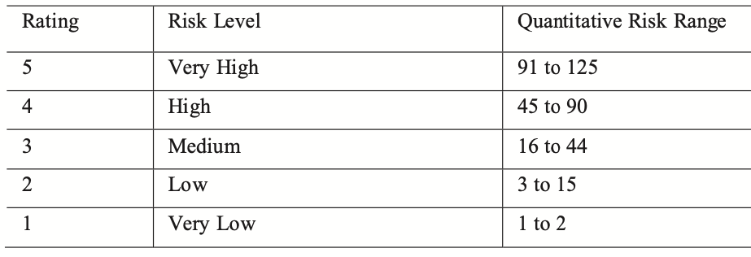
The methodology of risk assessment is to assemble the results of the Threat Assessment, Vulnerability Assessment, and Impact Assessment so as to determine a numeric value of risk for each asset and threat pair in accordance with the following expression:
Risk Rating(R) = Threat Rating (T) x Vulnerability Rating (V) x Impact Rating (I)
The values of T, V and I are derived from the respective assessments

Slide 35
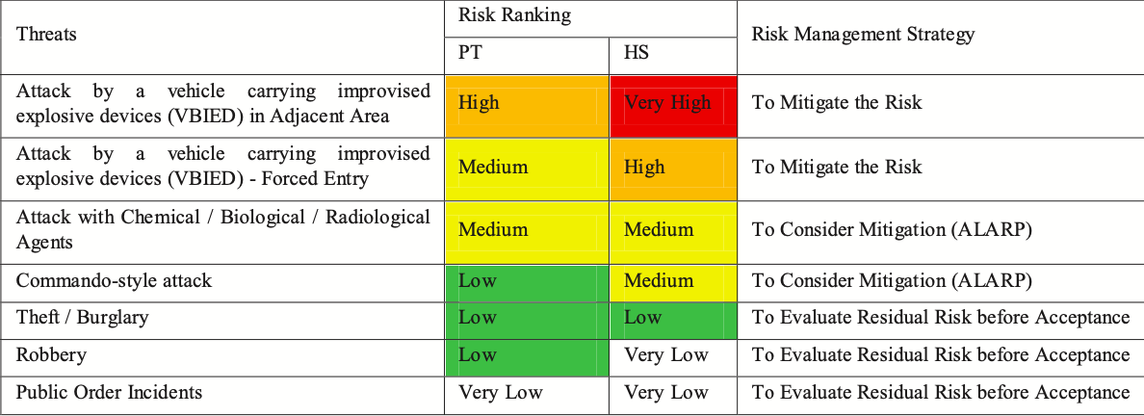
Example of Risk Ranking

Slide 36
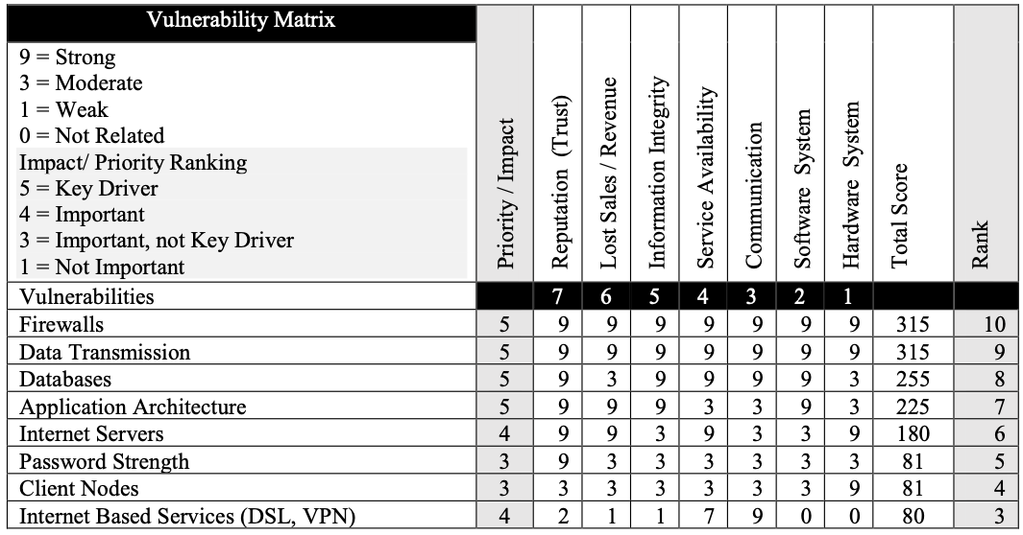
Example: vulnerability matrix

Slide 37
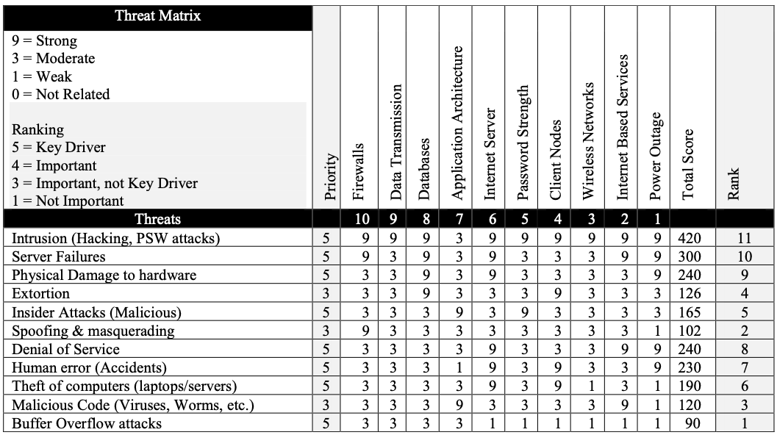
Example: threat matrix

Slide 38
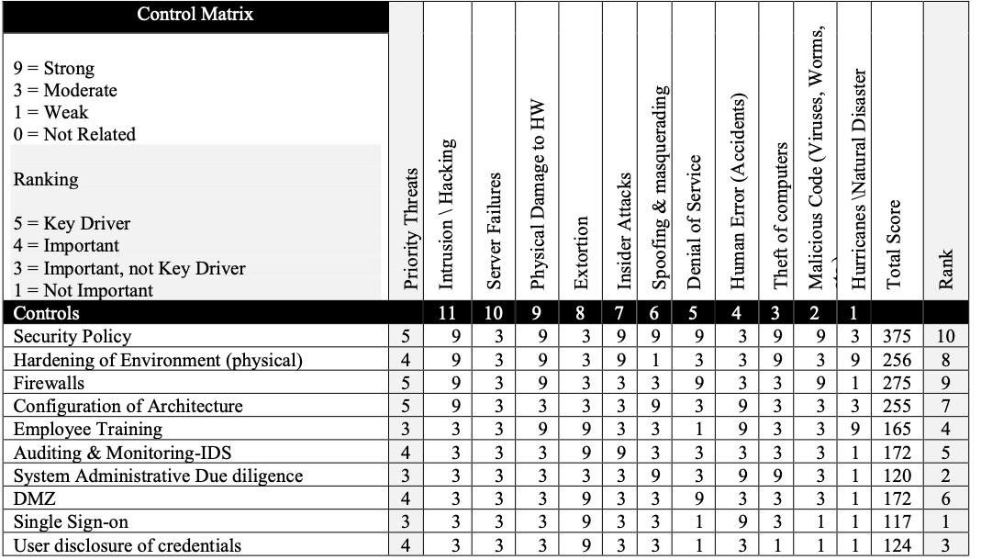
Example: Control matrix

Slide 39
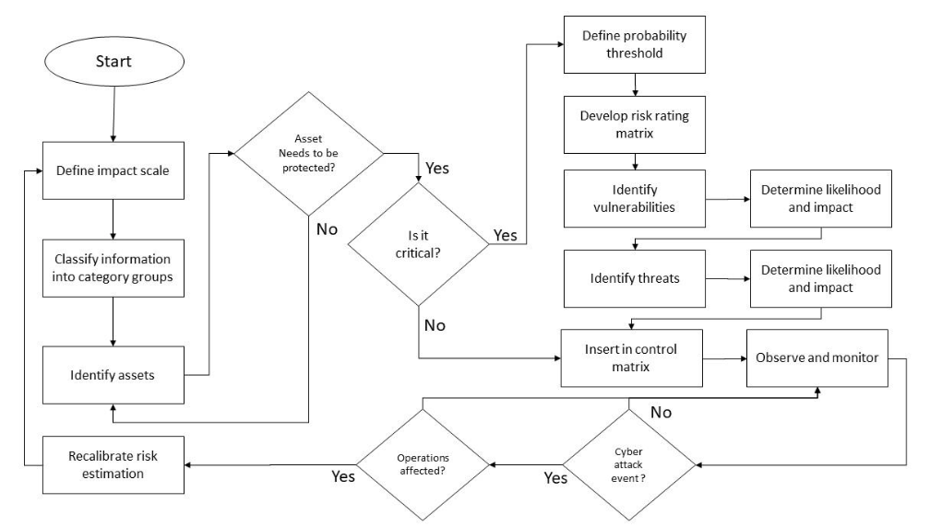

Slide 40
The steps to risk assessment are:
Identify threats and threat agents
Prioritize threats and threat agents
Assess vulnerabilities in current InfoSec plan
Determine risk of each threat
R = P * V – M + U
R = Risk
P = Probability of threat attack
V = Value of Information Asset
M = Mitigation by current controls
U = Uncertainty of vulnerability

Slide 41
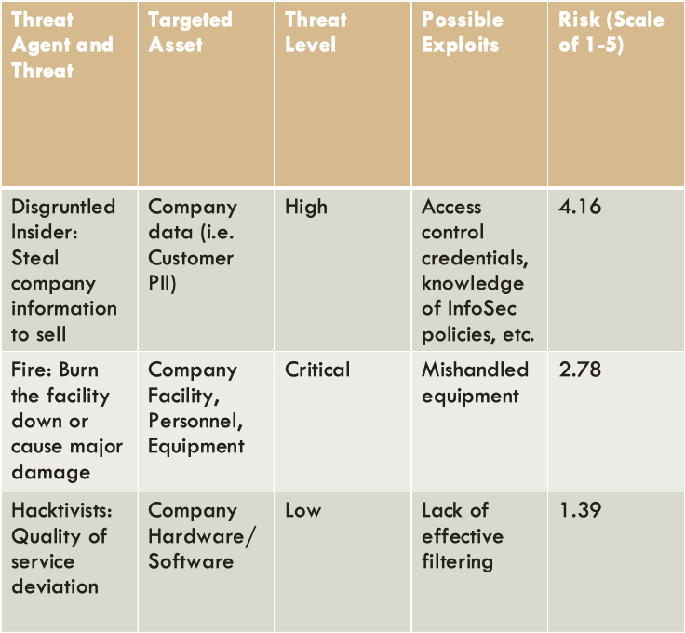

Slide 42
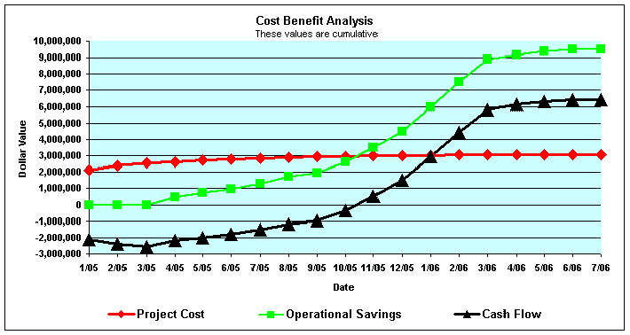
Cost-Benefit analysis
Determine what risk control strategies are cost effective
Below are some common formulas used to calculate cost-benefit analysis
SLE = AV * EF
AV = Asset Value, EF = Exposure factor (% of asset affected)
ALE = SLE * ARO
CBA = ALE (pre-control) – ALE (post-control) – ACE

Slide 43
The Annualised Loss Expectancy (ALE) from information security breaches is worked out empirically from the organisation’s experience and intelligence regarding intrusions, viruses, denial of service attacks and so on
ALE = SLE * ARO
SLE - Single Loss Exposure: estimated cost of the security incident
ARO - Annual Rate of Occurrence: probability of occurrence of incident

Slide 44
5. Risk treatment options
Defense
Transferal
Mitigation
Acceptance (Abandonment)
Termination

Slide 45
The steps to risk control are:
Cost-Benefit Analysis (CBA)
Single Loss Expectancy (SLE)
Annualized Rate of Occurrence (ARO)
Annual Loss Expectancy (ALE)
Annual Cost of the Safeguard (ASG)
Feasibility Analysis
Organizational Feasibility
Operational Feasibility
Technical Feasibility
Political Feasibility
Risk Control Strategy Implementation

Slide 46
Risk control Strategy: defense
Defense: Prevent the exploitation of the system via application of policy, training/education, and technology. Preferably layered security (defense in depth)
Counter threats
Remove vulnerabilities from assess
Limit access to assets
Add protective safeguards

Slide 47
Risk control Strategy: transferal
Transferal: Shift risks to other areas or outside entities to handle
Can include:
Purchasing insurance
Outsourcing to other organizations
Implementing service contracts with providers
Revising deployment models

Slide 48
Risk control Strategy: Mitigation
Mitigation: Creating plans and preparations to reduce the damage of threat actualization
Preparation should include:
Incidence Response Plan
Disaster Recovery Plan
Business Continuity Plan

Slide 49
Risk control Strategy: Acceptance
Acceptance: Properly identifying and acknowledging risks, and choosing to not control them
Appropriate when:
The cost to protect an asset or assets exceeds the cost to replace it/them
When the probability of risk is very low and the asset is of low priority
Otherwise acceptance = negligence

Slide 50
Risk control Strategy: Termination
Termination: Removing or discontinuing the information asset from the organization
Examples include:
Equipment disposal
Discontinuing a provided service
Firing an employee

Slide 51
Pros and cons of each strategy
PROS:
Defense: Preferred all round approach
Transferal: Easy and effective
Mitigation: Effective when all else fails
Acceptance: Cheap and easy
Termination: Relatively cheap and safe

Slide 52
Pros and cons of each strategy
CONS:
Defense: Expensive and laborious
Transferal: Dependence on external entities
Mitigation: Guarantees company loss
Acceptance: Rarely appropriate, unsafe
Termination: Rarely appropriate, requires company loss

Slide 53
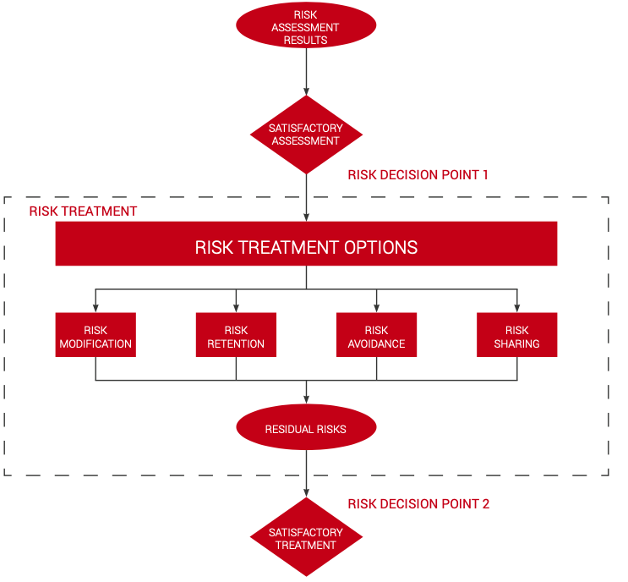

Slide 54
Residual risk
The residual risk is the amount of risk associated with an action or event remaining after natural or inherent risks have been reduced by risk controls
The general formula to calculate residual risk is
residual risk = (inherent risk)−(impact of risk controls)
Inherent risk is current risk level given the existing set of controls rather than the hypothetical notion of an absence of any controls
Residual risk would then be whatever risk level remain after additional controls are applied

Slide 55
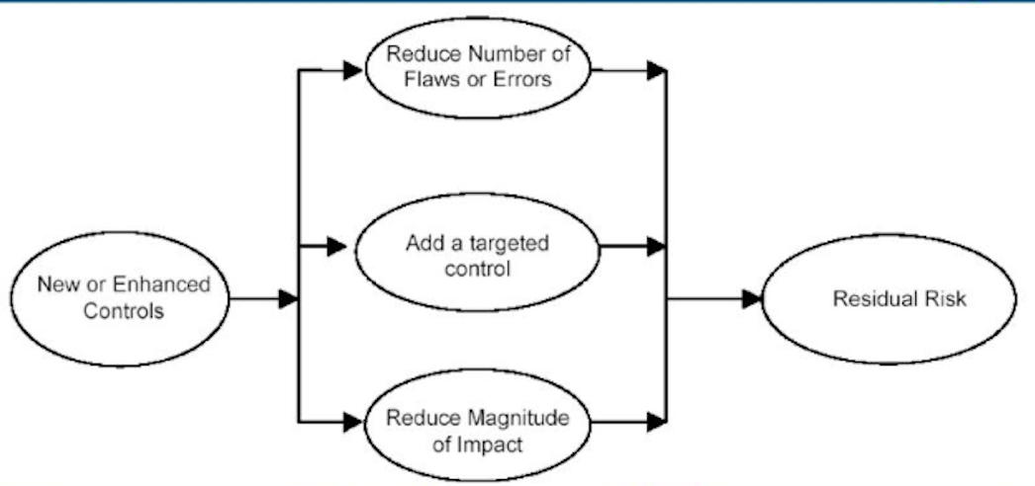
Residual risk

Slide 56
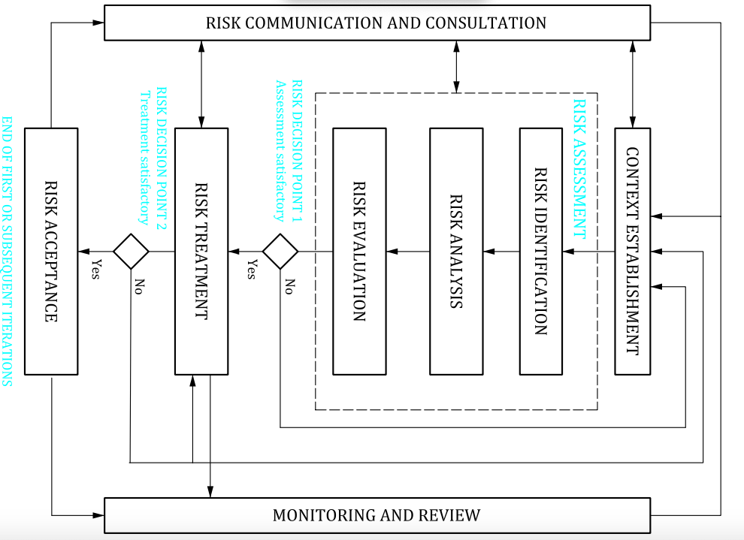

Slide 57
6. Risk monitoring
New assets within the scope of risk management
Modified asset values
New threats
New vulnerabilities
Increased impact or consequences which result in unacceptable level of risk
Information security incidents

Slide 58
Information security standards and methods
ISO/IEC 27005
ISO 31000
OCTAVE – Operationally Critical Threat, Asset, and Vulnerability Evaluation
EBIOS - Expression des Besoins et Identification des Objectifs de Sécurité developed by ANSSI in France
MEHARI method – Method for Harmonized Analysis of Risk
NIST 800-30 – National Institute of Standards and Technology
Harmonized TRA method – (The Right Approach)

Slide 59
Resources:
M. Whitman, H. Mattford. , Management of information security, Fourth Edition, Stamford, CT: Cengage Learning, 2014
Computer Security: Art and Science by Matt Bishop (ISBN: 0-201-44099-7), Addison-Wesley 2003
Information technology — Security techniques — Information security management systems — Overview and vocabulary : ISO/IEC 27000
Information technology. Security techniques. Information security risk management: BS ISO/IEC 27005
https://www.iso27001security.com/ISO27k_Standards_listing.pdf

